Slide 1


ANN training using ADAM optimizer
Neil Gogte
KMCE | DL 2024-25

Slide 2
ANN training using ADAM optimizer
It combines the advantages of two other popular optimization algorithms, AdaGrad and RMSProp, to make it adaptive to both sparse and dense gradients
ADAM (Adaptive Moment Estimation) optimizer is a widely used optimization algorithm in machine learning and deep learning, known for its efficiency and speed in training neural networks

Slide 3
Key Concepts in ADAM
Adaptive Learning Rates: ADAM adjusts the learning rate individually for each parameter based on estimates of the first and second moments (mean and uncentered variance) of the gradients.
Momentum: ADAM incorporates momentum, meaning it uses a moving average of the gradient to help smooth out the updates and accelerate convergence.
Bias Correction: To counteract the bias introduced by initializing the moving averages to zero, ADAM uses bias correction terms in the calculation.

Slide 4
How ADAM Works
ADAM combines two moving averages:
m: An exponential moving average of the gradient (first moment)
v: An exponential moving average of the squared gradient (second moment)
Each parameter update is computed using these averages, which makes the optimizer adaptive. The formulae for updating the parameters θ(theta) are as follows:

Slide 5
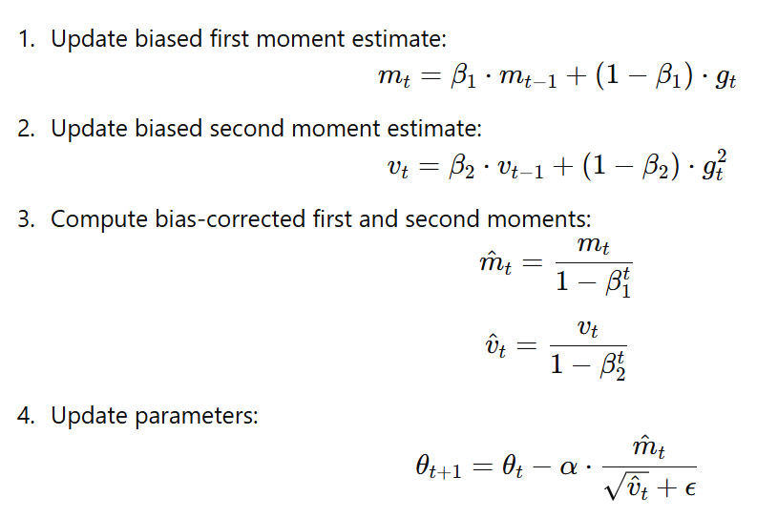
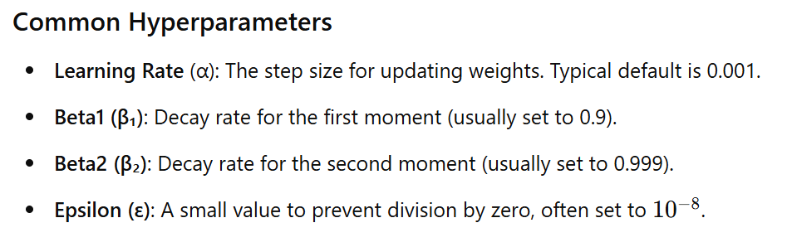
How ADAM Works

Slide 6
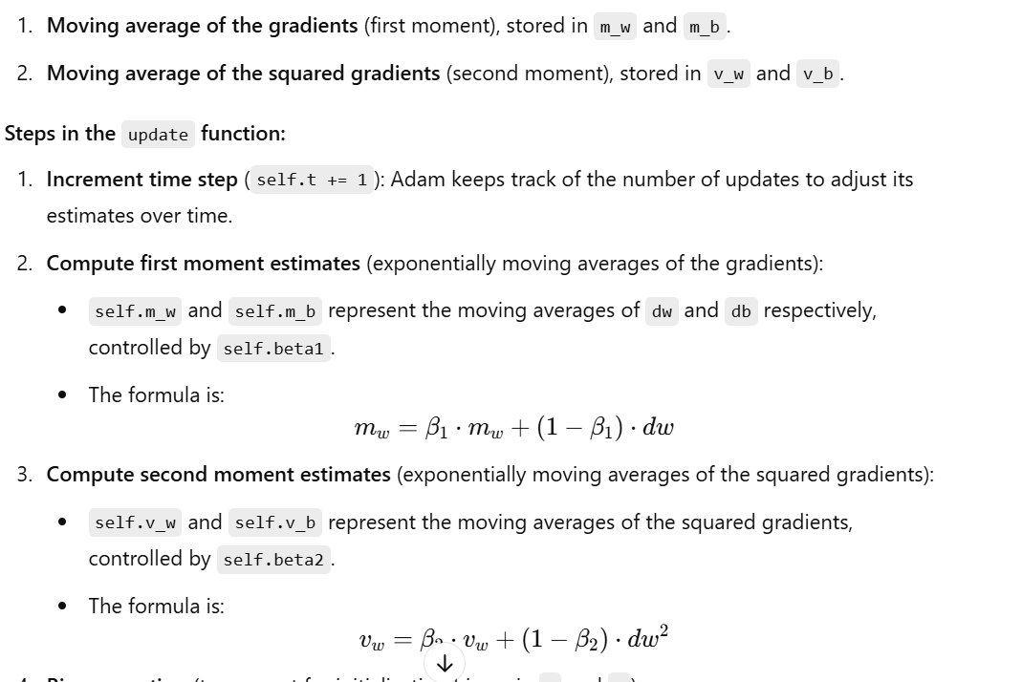
Code Explanation

Slide 7
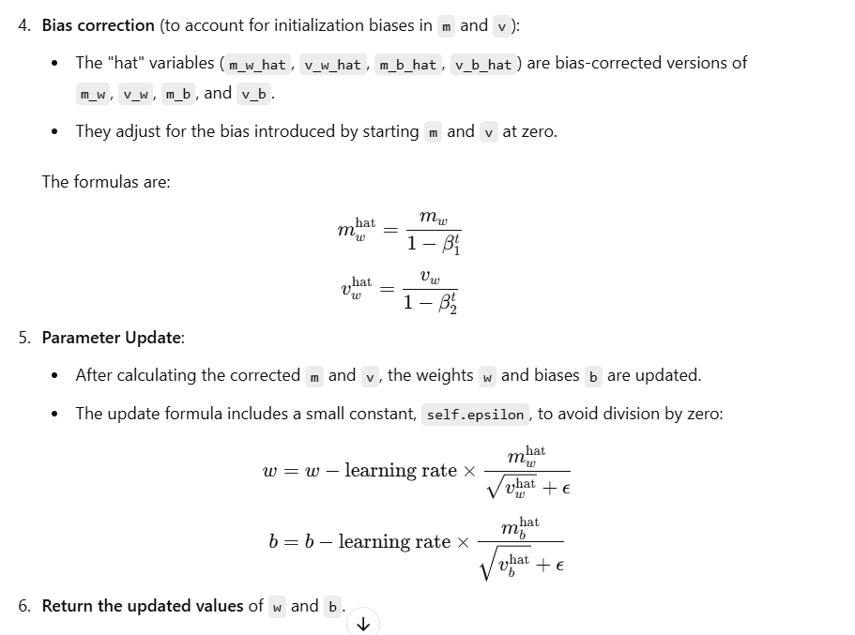

Slide 8
Applications
ADAM is widely used in training deep neural networks, such as in computer vision, natural language processing, and reinforcement learning tasks due to its versatility and adaptability.
It’s a popular choice for practitioners, but in recent years, newer optimizers like AdamW (a variant that includes weight decay) have also gained traction for further improving generalization

Slide 9
Thank You

